Slide 1
Open Source Platform and Network Administration
Lesson 20

Slide 3
Learning Objective and Key Concepts
Learning Objective
Assess the architecture of the Linux kernel and techniques used to enact a more secure kernel.
Key Concepts
Linux kernel architecture
Tuning, installing, and upgrading the Linux kernel
Options to consider in a stock versus custom kernel scenario
Steps to compile a custom kernel

Slide 4
Linux Kernel Architecture
Monolithic
Loadable kernel module (LKM)

Slide 5
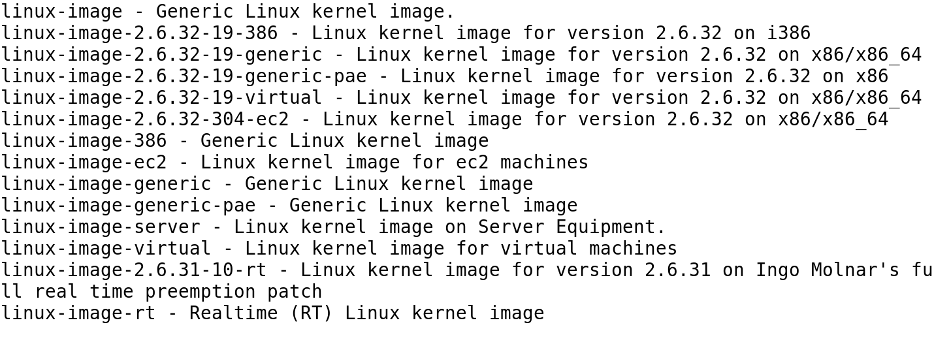
Ubuntu Kernel Package Options

Slide 6
Linux Kernel Architecture (Continued)
Subsystems
Process scheduler
Memory management
Virtual filesystem (VFS)
Network interface
Inter-process communication (IPC)

Slide 7
Linux Kernel Architecture (Continued)
Process Scheduler
Controls access to the central processing unit (CPU)
Interacts with the CPU
Determines which process will have access to the CPU
Interacts with the memory manager

Slide 8
Linux Kernel Architecture (Continued)
Memory Management
Consists of a virtual memory interface to the hardware memory
Controls access to random access memory (RAM)
Restricts access to user processes
Allows user processes to consume and release storage as well as memory maps for input and output

Slide 9
Linux Kernel Architecture (Continued)
VFS
Loads programs or an executable
Mounts a filesystem on the hardware
Manages all filesystems that are mounted
Provides a common interface for all processes

Slide 10
Linux Kernel Architecture (Continued)
Network Interface
Allows Linux to access other networks
Supports many network cards and protocols
Provides a common interface from the hardware to other subsystems
Allows a network card to interface with software and hardware
Interacts with the VFS and process scheduler subsystems

Slide 11
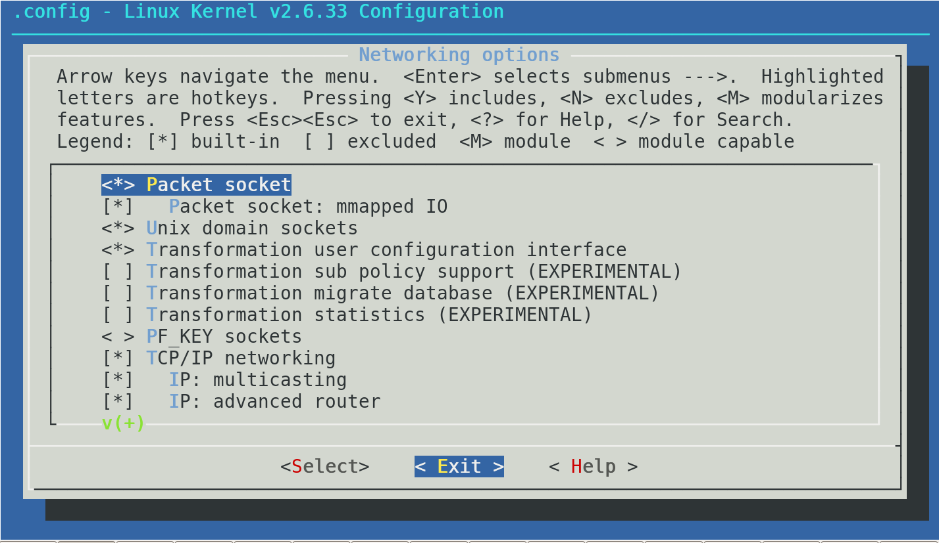
Kernel Networking Options

Slide 12
Linux Kernel Architecture (Continued)
IPC
Sends signals to processes
Sends signals in the following ways:
Message queues
Semaphores
Shared memory

Slide 13
Linux Kernel Architecture (Continued)
Assessing the Linux kernel architecture helps to:
Examine how memory and swap space are managed
Examine how modules interact with the kernel
Analyze the risks involved when adding new modules
Explore how networks interact with the kernel and the drivers and protocols that are available for use
Understand how filesystems are mounted and managed

Slide 14
Use of LKM in Securing Linux System
Advantages
Allows Linux to be a monolithic kernel
Loads modules as needed
Removes or unloads unneeded modules
Performs changes in hardware or any new module without recompiling the kernel

Slide 15
Use of LKM in Securing Linux System (Continued)
Disadvantages
Has access to kernel space and a poorly written LKM can impact the performance of the operating system
Is a source of rootkits and other malicious software that could gain access to kernel space

Slide 16
Patching the Linux Kernel (Version 2.6.35.4 )
Step 1
From the source tree (/usr/src/linux), download the patch from the Internet using the following command:
[root@is418 linux]# wget http://www.kernel.org/pub/linux/kernel/v2.6/patch-2.6.35.4.bz2
Step 2
Extract the file in the source tree using the following command:
[root@is418 linux]# bunzip2 patch-2.6.35.4.bz2
Notes:
Applying a patch to a custom kernel requires compiling the kernel again but this time with the new patch. The patch should be placed where the Linux source tree is located, which is usually in the /usr/src/linux directory.
Applying a kernel patch to a binary kernel that is part of a distribution: The package management software usually takes care of this process. Once the software applies and updates the patch, a new kernel version is placed in the /boot directory and an option to boot from it is added in the GRUB menu. The older kernel version is purposely left intact and should NOT be removed until the new patch starts working as expected, which could take several weeks or months.

Slide 17
Patching the Linux Kernel (Version 2.6.35.4 ) (Continued)
Step 3
Apply the patch using the following command:
root@is418 linux]#patch -p1 < patch-2.6.35.4
Step 4
Proceed to build the kernel as described in the textbook.

Slide 18
Persisting a Kernel Parameter Change
Step 1
Open the /etc/sysctl.conf file in a text editor.
Step 2
Find the directive net.ipv4.tcp_syncookies by using the directive net.ipv4.tcp_syncookies = 0

Slide 19
Persisting a Kernel Parameter Change (Continued)
Step 3
Change the directive's value by using the directive net.ipv4.tcp_syncookies = 1
Step 4
Save and exit.

Slide 20
Kernel Development Software
Red Hat Kernel Development Software
Ubuntu Kernel Development Software
Notes:
If any errors occur when issuing the make menuconfig command, it probably means that the ncurses libraries are not installed on the computer system.

